Slide 1
AF1001 Fundamentals of Accounting (BSE-3rd Semester)
Mr. Sami Ullah
Lecturer NU Fast Peshawar

Slide 2
Rule of Debit and Credit (Rules for recording Business transaction)
A ledger account (also known as T-account) consists of two sides – a left side and a right side. The left side is commonly referred to as debit side and the right side is commonly referred to as credit side. In practice, the term debit is denoted by “Dr” and the term credit is denoted by “Cr”.
In the rest of the discussion we shall use the terms debit and credit rather than left and right.

Slide 3
When a financial transaction occurs, it affects at least two accounts.
For example, purchase of machinery for cash is a financial transaction that increases machinery and decreases cash because machinery comes in and cash goes out of business.
The increase in machinery and decrease in cash must be recorded in the machinery account and the cash account respectively.
As stated earlier, every ledger account has a debit and a credit side. Now the question is that on which side the increase or decrease in an account is to be recorded.
The answer lies in the learning of normal balances of accounts and the rules of debit and credit.

Slide 4
Normal balance of accounts
The understanding of normal balance of accounts helps understand the rules of debit and credit easily. If the normal balance of an account is debit, we shall record any increase in that account on the debit side and any decrease on the credit side. If, on the other hand, the normal balance of an account is credit, we shall record any increase in that account on the credit side and any decrease on the debit side.
The normal balance of all asset and expense accounts is debit whereas the normal balance of all liabilities and equity (or capital) accounts is credit. The normal balance of a contra account is always opposite to the main account to which the particular contra account relates.

Slide 5
Rules of debit and credit
(1). Asset accounts:
Normal balance: Debit
Rule: An increase is recorded on the debit side and a decrease is recorded on the credit side of all asset accounts.
(2). Expense accounts:
Normal balance: Debit
Rule: An increase is recorded on the debit side and a decrease is recorded on the credit side of all expense accounts.

Slide 6
(3). Liability accounts:
Normal balance: Credit
Rule: An increase is recorded on the credit side and a decrease is recorded on the debit side of all liability accounts.
(4). Revenue/Income accounts:
Normal balance: Credit
Rule: An increase is recorded on the credit side and a decrease is recorded on the debit side of all revenue accounts.

Slide 7
(5). Capital/Equity accounts:
Normal balance: Credit
Rule: An increase is recorded on the credit side and a decrease is recorded on the debit side of all equity accounts.
(6) Contra accounts:
Normal balance: Always opposite to the relevant normal account. The normal balance of a contra account can be a debit balance or a credit balance
An example: Accounts receivable is an asset account that normally has a debit balance. The allowance for doubtful accounts is a contra account to the accounts receivable and normally has a credit (opposite) balance.

Slide 8
Other examples of contra accounts include:
accumulated depreciation account – a contra asset account
sales returns and allowances account – a contra revenue account
sales discount account – a contra revenue account
drawings account – a contra equity account
treasury stock account – a contra equity account
bonds discount account – a contra liability account
For example, if the balance in building account is $500,000 and the balance in accumulated depreciation – building account is $150,000, the building would be reported at $350,000 (= $500,000 – $150,000) in the balance sheet.

Slide 9
Rule: If the normal balance of the contra account is debit, the increase will be recorded on the debit side and the decrease will be recorded on the credit side. If, on the other hand, the normal balance of the contra account is credit, the increase is recorded on the credit side and the decrease is recorded on the debit side.

Slide 10
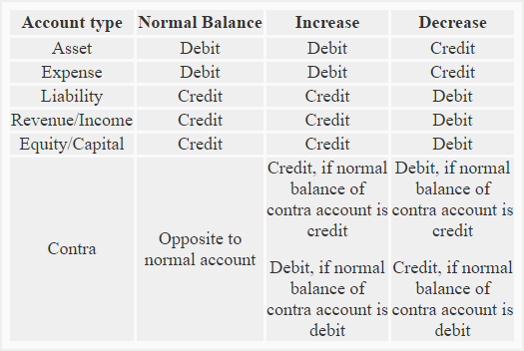
A summary of the whole discussion about rules of debit and credit is given below:

Slide 11
Example:
The following transactions are related to Small Traders:
Started business with cash $95,000.
Furniture purchased for cash to be used in business $8,000.
Purchased goods for cash $40,000.
Purchased goods on credit from Big Traders $57,000.
Sold goods for cash $5,000.
Purchased equipment for business $4,000.
Sold goods on credit to John Retailers $1,500.
Paid salary to employees $1,200

Slide 12
Required: Identify the accounts involved in above transactions and state the nature of each account. Also mention how increases or decreases in accounts resulting from above transactions should be recorded.

Slide 13
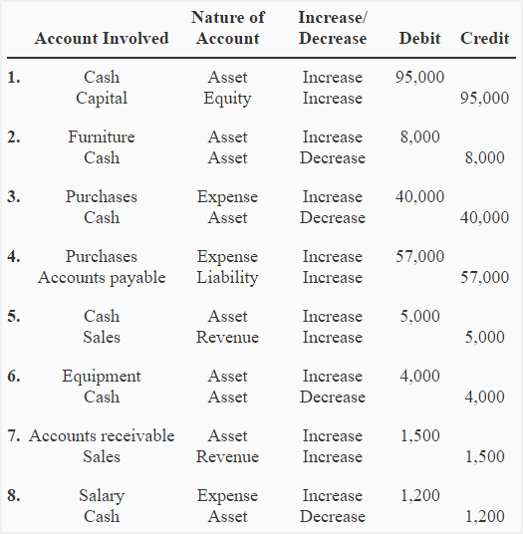

Slide 14
Five Basic Questions for Transaction Analysis: 1. What's going on? 2. What accounts are affected? 3. How are they affected? 4. Does the balance sheet balance? 5. Does the analysis make sense?

Slide 15
Accrual Accounting vs. Cash Basis Accounting
The main difference between accrual and cash basis accounting lies in the timing of when revenue and expenses are recognized. The cash method is a more immediate recognition of revenue and expenses, while the accrual method focuses on anticipated revenue and expenses.
Accrual Basis Accounting
Revenue is accounted for when it is earned. Typically, revenue is recorded before any money changes hands. Unlike the cash method, the accrual method records revenue when a product or service is delivered to a customer with the expectation that money will be paid in the future. Expenses of goods and services are recorded despite no cash being paid out for those expenses.

Slide 16
Cash Basis Accounting
Revenue is reported on the income statement only when cash is received. Expenses are only recorded when cash is paid out.
The cash method is mostly used by small businesses and for personal finances.

